Slide 1

E-CHECKOUT
(For e-Shawl & e-Carpet Designers)
Manoj Sisodia

Slide 2
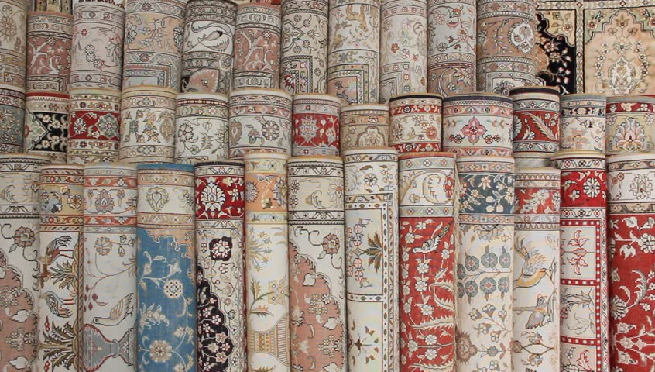
Contents
What is e-Checkout ?
Registration Frame
Login Frame
Views
Class Diagram
Use Case Diagram
Technical Platforms Used
Limitations
Summary
Conclusion

Slide 3
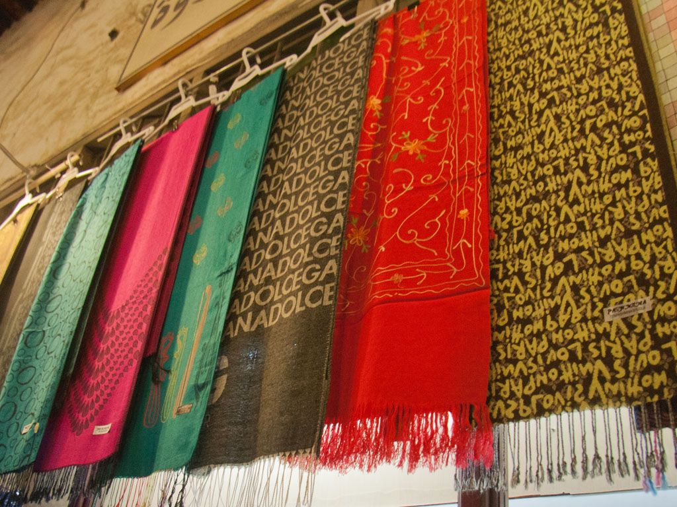
What is e-Checkout ?
Checkout process represents a fully customizable mechanism that the customers need to go through to purchase products offered in an online store.
The checkout process is automatic and no direct involvement of a staff is needed.

Slide 4
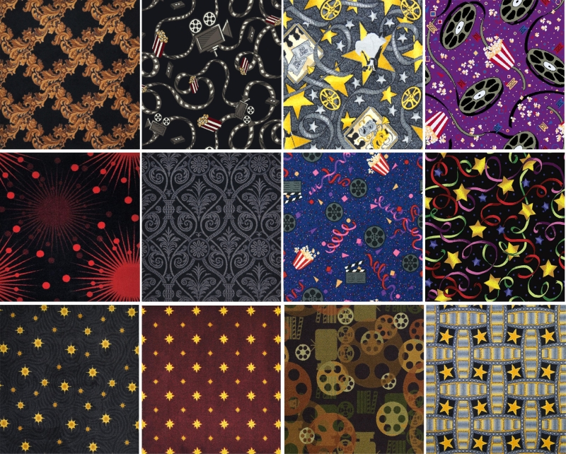
Registration Frame

Slide 5
Login Frame

Slide 6
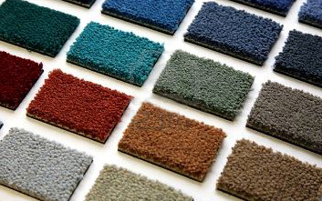
Views
In this project views are divided into 3 parts:-
Admin view
Staff view
Customer view
According to Login credentials Application will show the respective view that is for user or admin.

Slide 7
Admin view
Admin used to view his profile
Change password.
Update profile detail of customer and staff.
Admin can add, update, delete and view product detail.
Admin can also delete and view who were register with our system
Admin can view and update order detail.

Slide 8
Admin Frame

Slide 9
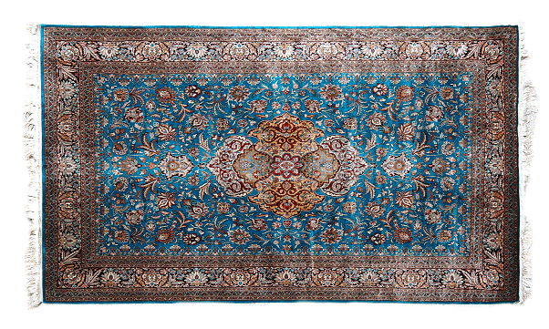
Display Customer

Slide 10

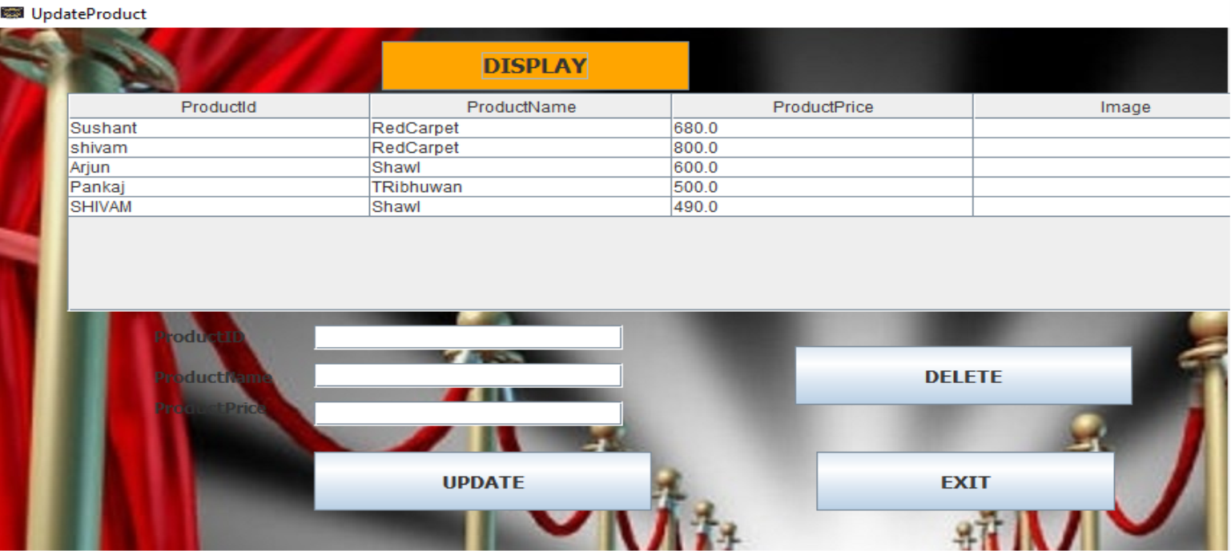
Update & Delete Product

Slide 11
Upload Product

Slide 12
Staff view
Staff can view his profile
Change password
Check the products.
Solve problems of customers related to products.

Slide 13
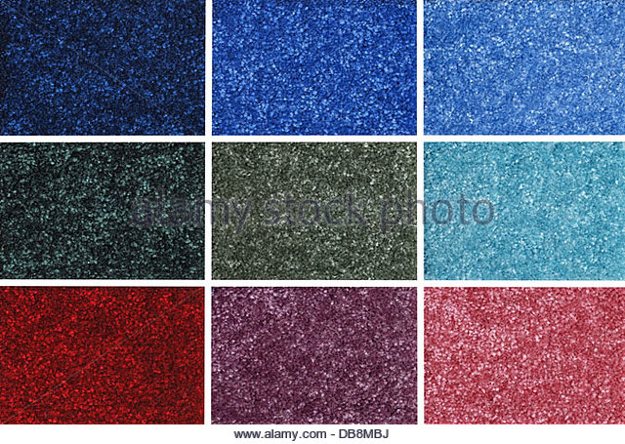
Staff Frame

Slide 14
Customer view
Browse
Search products
Add on the cart
Give review to products
Read reviews
Delete from the cart

Slide 15
Customer Frame

Slide 16
Checkout Page

Slide 17
Checkout Page Continued..

Slide 18
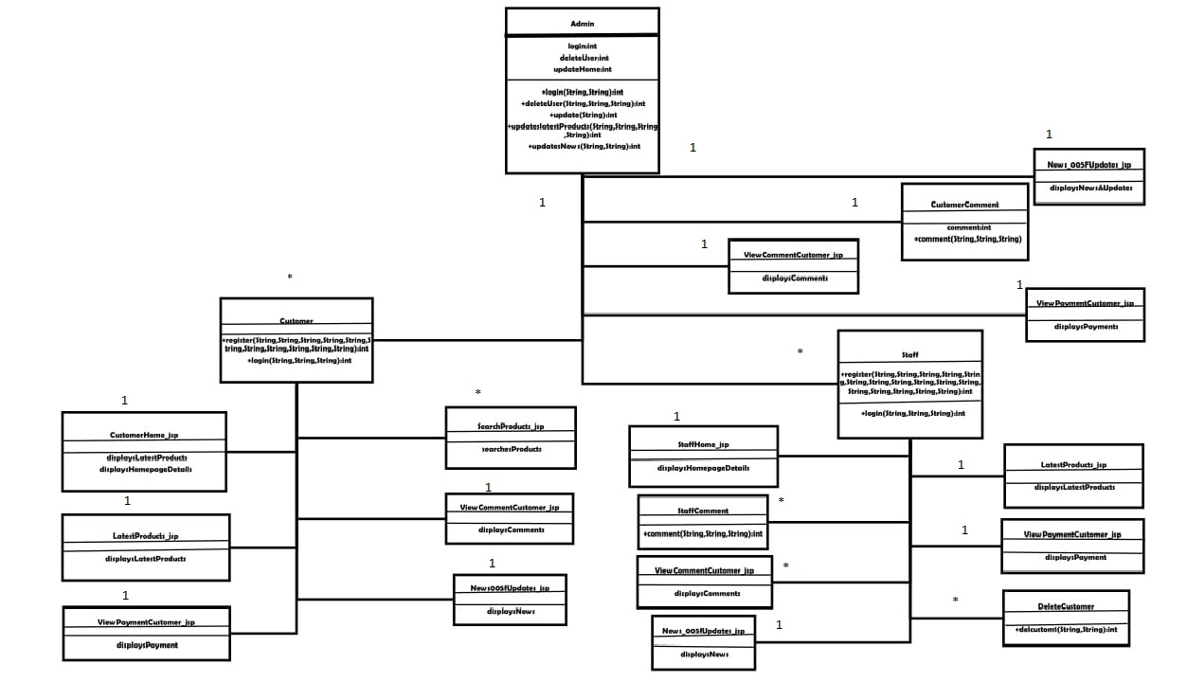
Class Diagram

Slide 19
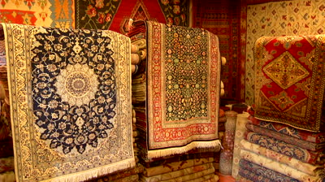
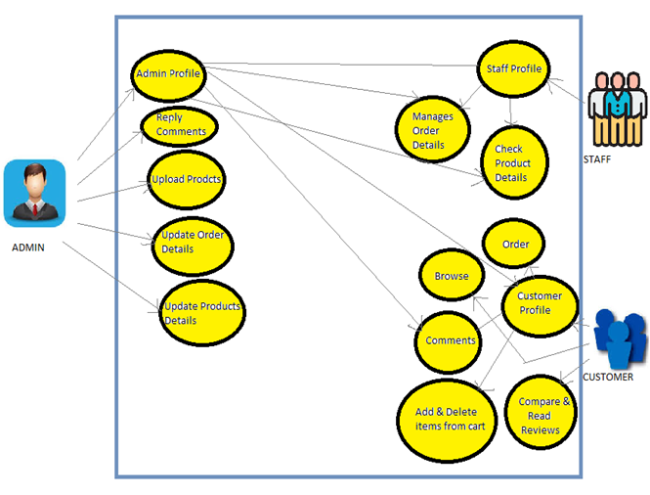
Use Case Diagram

Slide 20
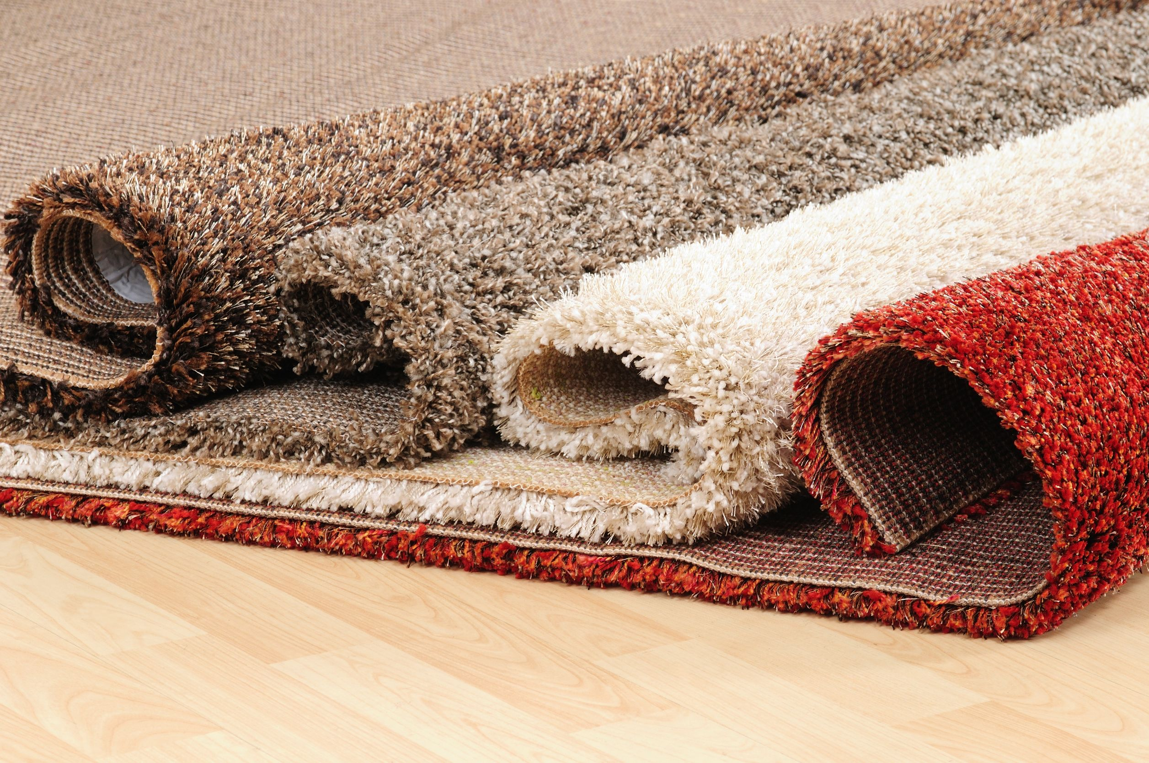
Technical Platforms Used

Slide 21

Limitations
No bargaining advantage.
Not able to touch or try on.
Data loss may occur.

Slide 22
Summary
This project deals with developing an application for e-shawl & e-carpet Sale. It provides the user with a catalogue of different shawl & carpets available for add to the cart. The system is implemented using a 3-tier approach. This is a project with the objective to develop a basic application where a consumer is provided with a shopping cart.

Slide 23
Conclusion
From this E-CHECKOUT project we conclude that it was a lovely experience working with each other. We have gained concepts which we were un aware of.
We team13 want to thank our trainer “Debashish Barua” for giving us an opportunity to work on this project ,and guiding us in all circumstances as well as providing us the knowledge which will be helpful in our future carrier.

Slide 24
